Slide 1
Lecture : Heap, Heap Sort

Slide 2
Overview
Heaps
Heapsort

Slide 3
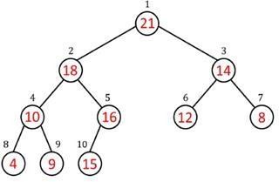
Heaps
Complete binary tree: All levels are completely filled except the lowest, every node should reside on the left side.
Heap is Not a BST, Heap is a complete BT with heap property maintained
Must satisfy the heap property.
Max Heap property for Max Heaps
Min Heap property for Min Heaps
Heaps

Slide 4
Heap properties
Root: Only node with no parent
Leaf: Node without any children
Heap size: Number of nodes in heap
Height of a node is number of edges along longest simple downward path from node to a leaf
Leaves have height h = 0
Root in example above has height h = 3
Height of root is height of tree/heap
Height of tree is Θ(h) = Θ(lg n) = Θ(log n). [always because, its complete BT]
Heaps

Slide 5
Why Choose Array Over Linked List for Heap
Why Use an Array for Heaps:
O(1) parent/child access: allow random access via indices, making parent/child lookup trivial/straightforward.
Space efficiency for complete trees: As a complete binary tree, the heap is never skewed, so array slots are utilized with minimal gaps.
Why Not Linked Lists:
Sequential access: Locating a specific node requires traversal starting from root
Higher memory overhead: Each node needs multiple references (parent, left, right).

Slide 6
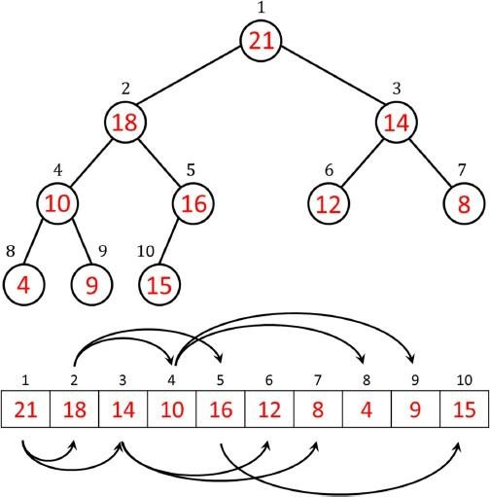
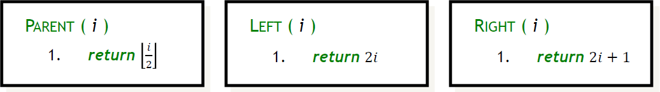
Heap as array
Since heap is a complete tree, we can conveniently represent it as an array
Do not need to represent edges explicitly
Indexing follows the same method as in BT/BST.
Given the index of a node, we can easily compute the indices of its parent, left child and right child.
Heaps

Slide 7
Heap as array properties
The root of the tree is A[1].
A node has 0, 1 or 2 children. (if a node has 1 child, it should be on left side)
A node with no child is called a leaf.
A node with at least one child is called an internal node.
Heaps

Slide 8
Unless explicitly stated as max heap or min heap, heap means max heap in this course.

Slide 9
Max Heap Property
Each node i > 1 satisfies the max-heap property: A[Parent(i )] ≥ A[i]. Here, A[i] is an internal node.
Parent always greater than both of its children/child.
Hence, the largest element in a max-heap is stored at the root.
We will use max-heaps in the heapsort algorithm
It can be viewed as improved selection sort. (In-place)
Heaps

Slide 10
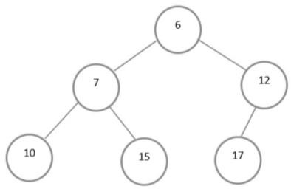
Min Heap Property
Each node i > 1 satisfies the min-heap property: A[Parent(i )] ≤ A[i]. Here, A[i] is an internal node.
Hence, the smallest element in a min-heap is stored at the root.
Min-heaps commonly implement priority queues which have many applications, e.g., in shortest paths computation.
Heaps

Slide 11
Home Work
Is the array with values (23, 17, 14, 6, 13, 10, 1, 5, 7, 12) a max-heap?
Heaps
18/27

Slide 12
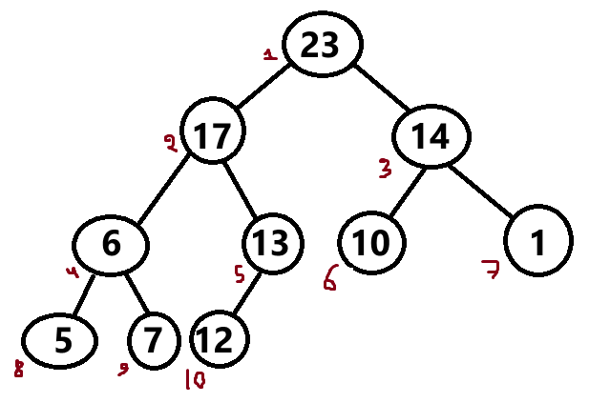
Home Work
Is the array with values (23, 17, 14, 6, 13, 10, 1, 5, 7, 12) a max-heap? 1 2 3 4 5 6 7 8 9 10
Heaps
18/27

Slide 13
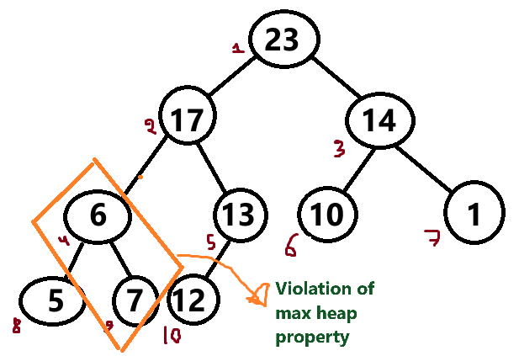
Home Work
Is the array with values (23, 17, 14, 6, 13, 10, 1, 5, 7, 12) a max-heap? 1 2 3 4 5 6 7 8 9 10
Heaps
18/27

Slide 14
Operations on max heap
max-heapify(A, i ) – Ensure the heap property of A, array starting at node i . Also known as “sink” operation since it sinks the lighter elements down the tree.
heap-increase-key(A, i , key ) – Increase the value of element at node i to key, and ensure the heap property of A by moving larger elements upwards. Also known as “swim” operation as it moves larger elements upwards.
max-heap-insert(A, key ) – Insert key in the heap A, maintaining A’s heap property.
get_maximum(A): return element with largest key
heap-extract-max(A) – Extract the largest element from heap A. Referred as “Delete_max” in the notes
build-max-heap(A) – Build a max heap given an array A.
heapsort(A) – Sort the elements in array A using the heap operations.
Get_heap_size(): Number of nodes in heap
Heaps
18/27

Slide 15
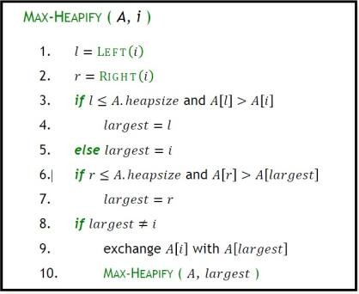
Maintaining the heap property
Precondition:
Subtree rooted at Left(i ) is max heap
Subtree rooted at Right(i ) is max heap
Postcondition:
After Max − Heapify(A, i ) completes, the subtree rooted at i will be a max heap
Heaps
21/27

Slide 16
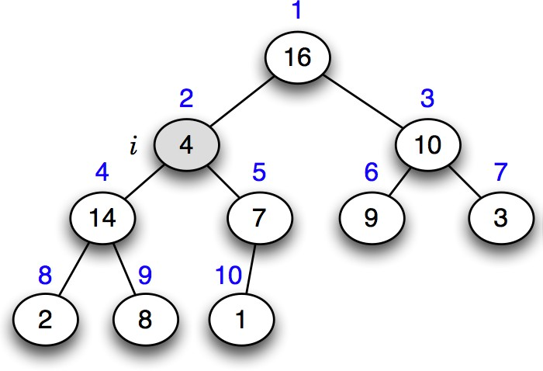
Example of max-heapify (“sink”) operation
Mumit Khan
13 / 29

Slide 17
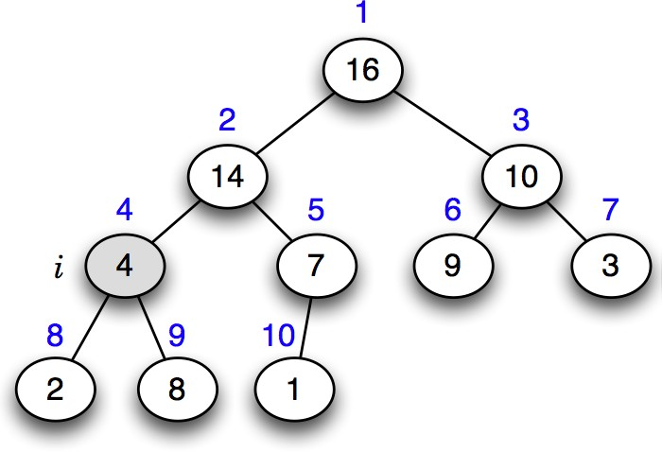
Example of max-heapify (“sink”) operation
Mumit Khan
13 / 29

Slide 18
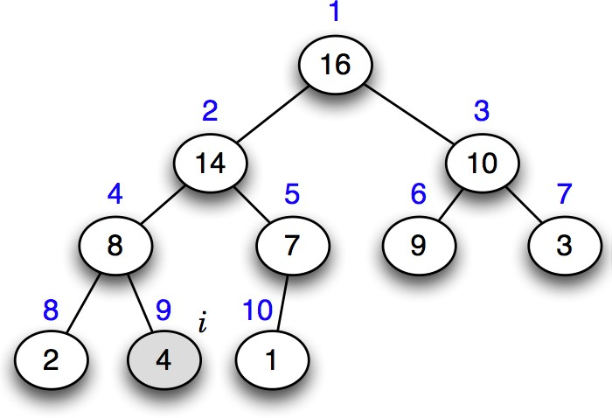
Example of max-heapify (“sink”) operation
Mumit Khan
13 / 29

Slide 19
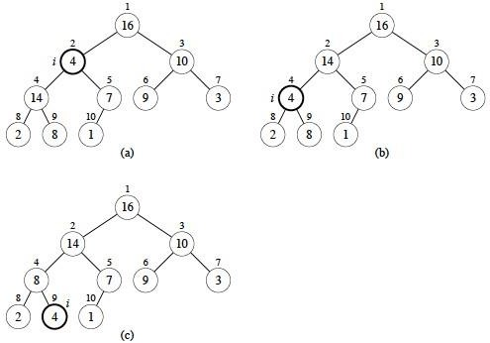
Max − Heapify (“sink”) Example
A= [16, 4, 10, 14, 7, 9, 3, 2, 8, 1]
Heaps
Source: https://www2.hawaii.edu/~nodari/teaching/s18/Notes/Topic-09.html

Slide 20
Heap-increase-key (“swim”) operation algorithm
heap-increase-key(A, i , key )
if key < A[i ]
then error “new key is smaller than current key”
A[i ] ← key
while i > 1 and A[parent(i )] < A[i ]
do exchange A[i ] ↔ A[parent(i )]
i ← parent(i )
Time complexity:
A node may move from leaf to root due to increased value, So, T(n) = O(h) = O(log n).
Mumit Khan
16 / 29

Slide 21
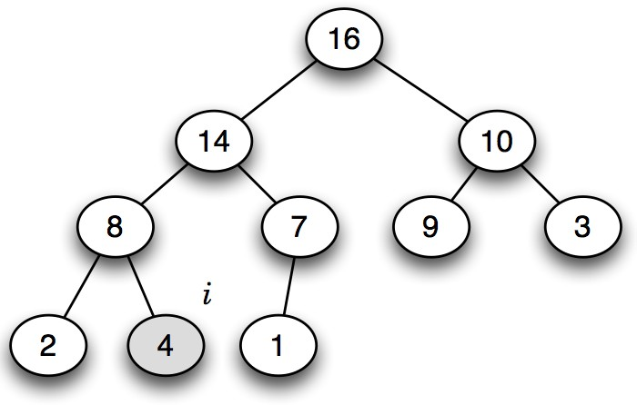
Example of heap-increase-key (“swim”) operation
Mumit Khan
15 / 29

Slide 22

Example of heap-increase-key (“swim”) operation
Mumit Khan
15 / 29

Slide 23
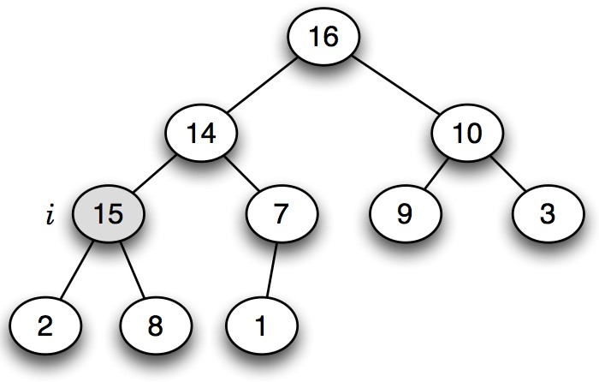
Example of heap-increase-key (“swim”) operation
Mumit Khan
15 / 29

Slide 24
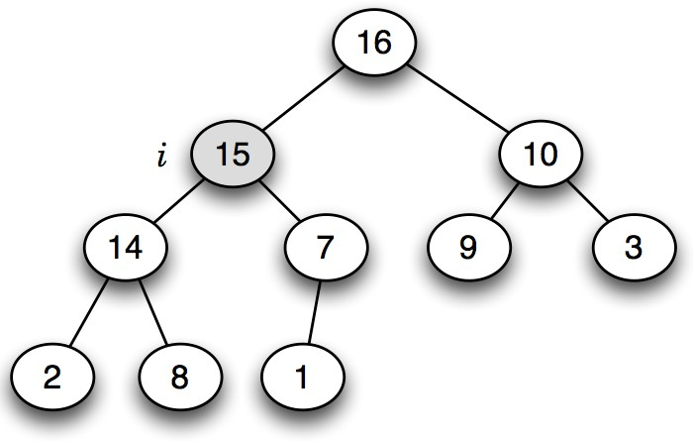
Example of heap-increase-key (“swim”) operation
Mumit Khan
15 / 29

Slide 25
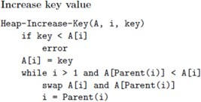
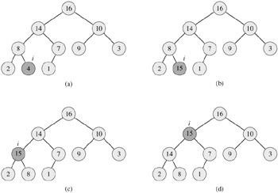
Heap-increase-key (“swim”) operation
(a) The max-heap with a node whose index is i heavily shaded. (b) This node has its key increased to 15 from 4.
(c) After one iteration of the while loop of lines 4-6, the node and its parent have exchanged keys, and the index i moves up to the parent. (d) The max-heap after one more iteration of the while loop. At this point, A[PARENT(i)] ≥ A[i]. The max-heap property now holds and the procedure terminates.

Slide 26
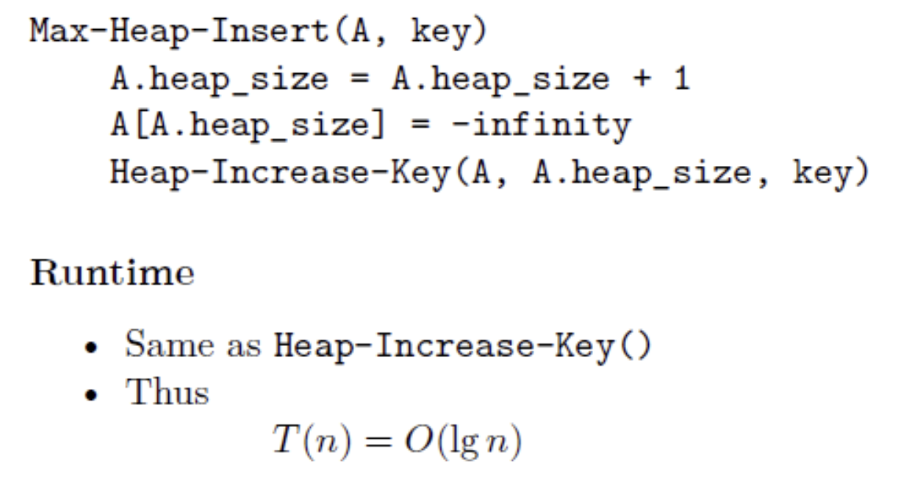
Max heap insert operation
New element always inserted as a last element of the array (leaf)
Then heap-increase-key() is called on that element

Slide 27
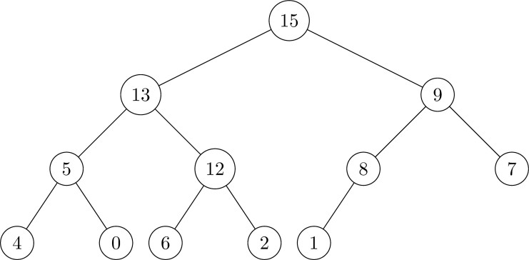
Max heap insert operation (Example1)
Illustrate the operation of MAX-HEAP-INSERT(A,10) on the heap A=⟨15, 13 , 9, 5, 12, 8, 7, 4, 0, 6, 2, 1, NONE⟩ 1 2 3 4 5 6 7 8 9 10 11 12 13
1. Original heap

Slide 28
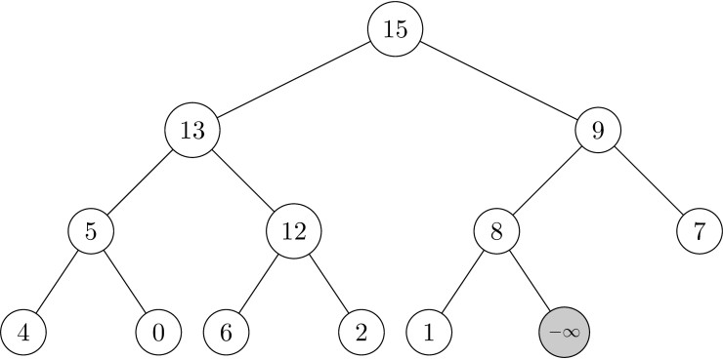
Max heap insert operation (Example1)
Illustrate the operation of MAX-HEAP-INSERT(A,10) on the heap A=⟨15,13,9,5,12,8,7,4,0,6,2,1⟩
2. Since MAX-HEAP-INSERT(A,10) is called, we append a node assigned value −∞

Slide 29
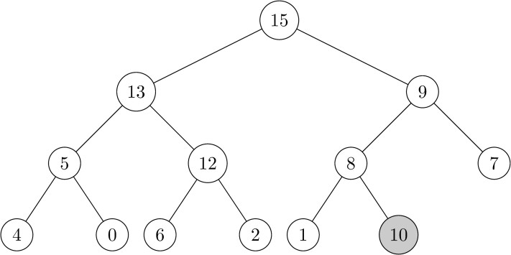
Max heap insert operation (Example1)
Illustrate the operation of MAX-HEAP-INSERT(A,10) on the heap A=⟨15,13,9,5,12,8,7,4,0,6,2,1⟩
3. Update the key value of the new node.

Slide 30
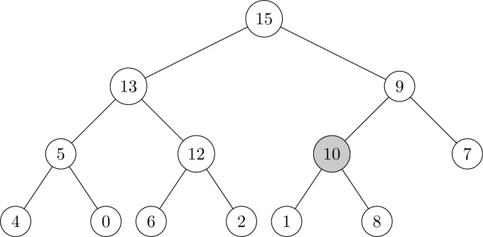
Max heap insert operation (Example1)
Illustrate the operation of MAX-HEAP-INSERT(A,10) on the heap A=⟨15,13,9,5,12,8,7,4,0,6,2,1⟩
4. Update the key value of the new node.

Slide 31
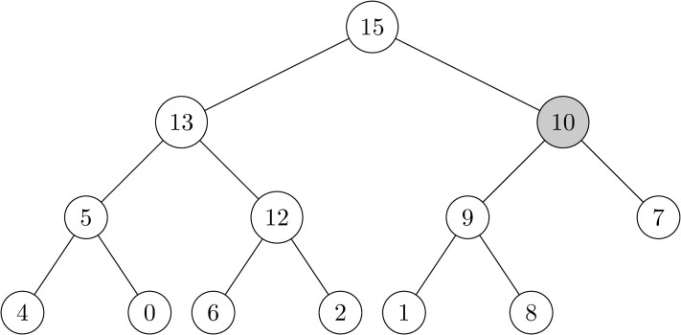
Max heap insert operation (Example1)
Insert into queue - Example
Illustrate the operation of MAX-HEAP-INSERT(A,10) on the heap A=⟨15,13,9,5,12,8,7,4,0,6,2,1⟩
5. Since the parent key is smaller than 10, the nodes are swapped. (Swim up)

Slide 32
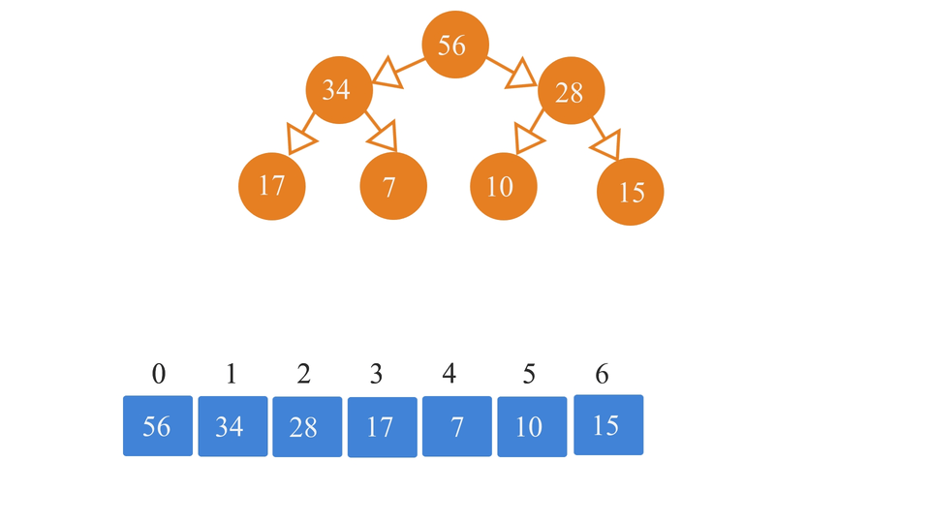
Max heap insert operation (Example2)

Slide 33
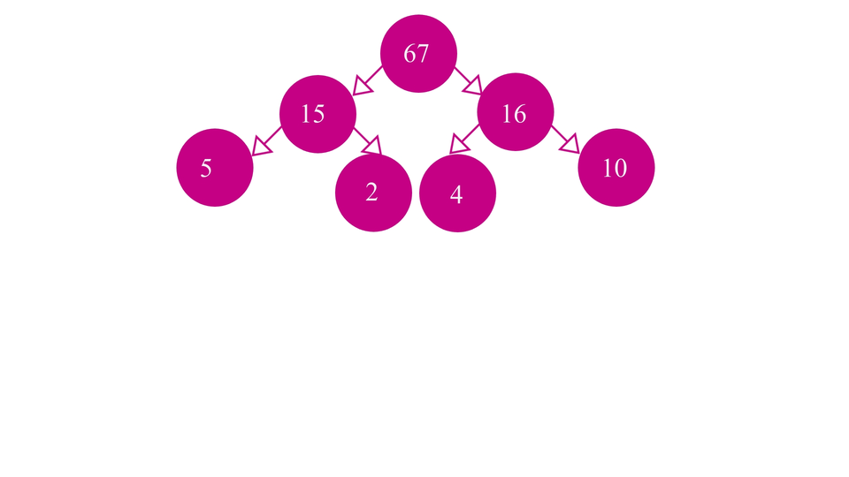
Max heap insert operation (Example3)

Slide 34
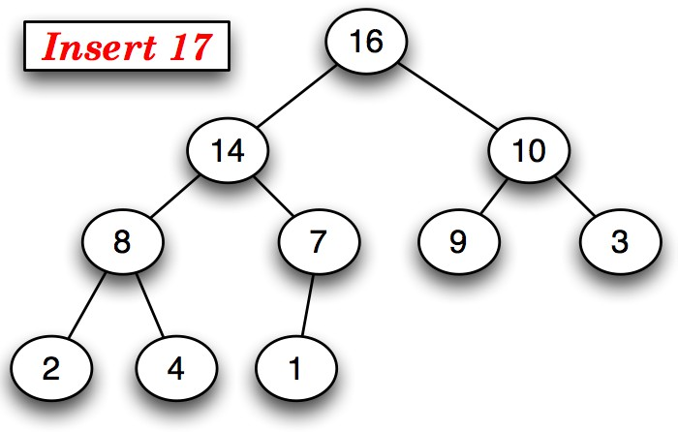
max-heap-insert operation (Example4)
Mumit Khan
17 / 29

Slide 35
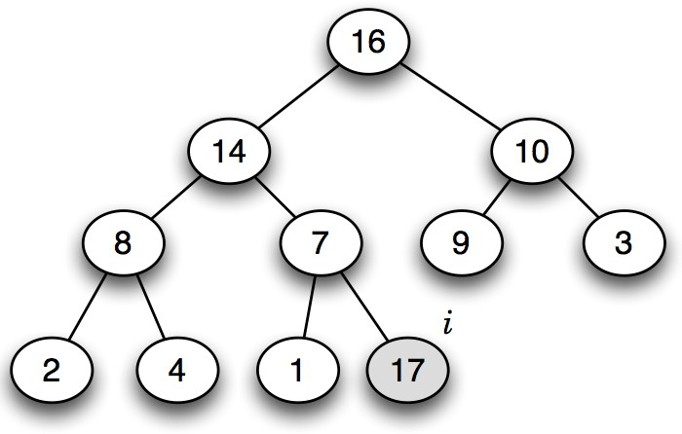
max-heap-insert operation (Example4)
Mumit Khan
17 / 29

Slide 36
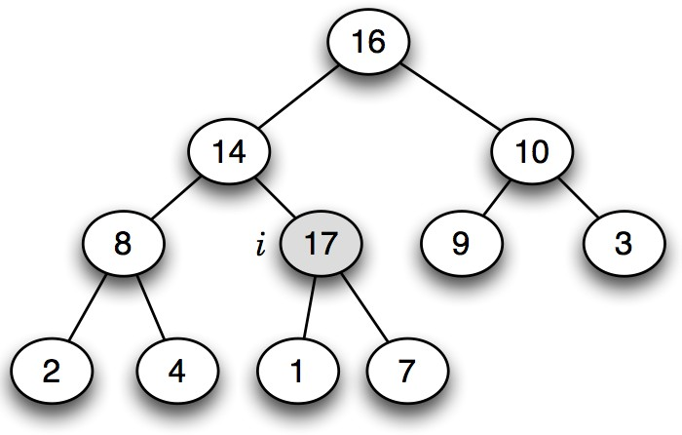
max-heap-insert operation (Example4)
Mumit Khan
17 / 29

Slide 37
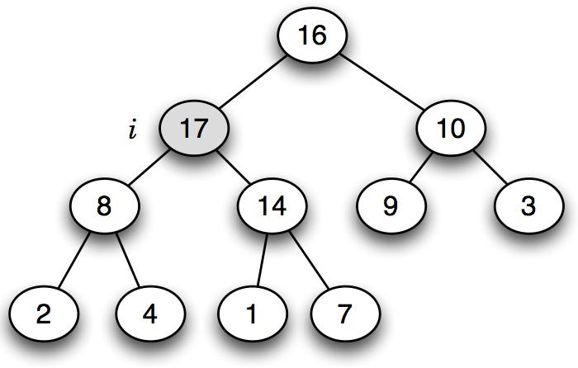
max-heap-insert operation (Example4)
Mumit Khan
17 / 29

Slide 38
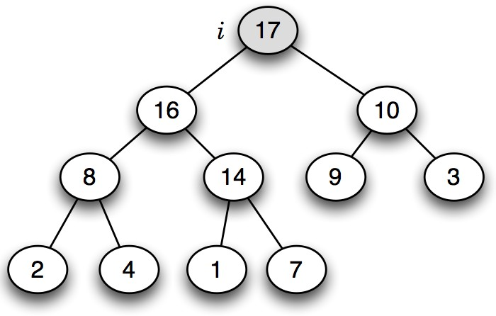
max-heap-insert operation (Example4)
Mumit Khan
17 / 29

Slide 39
Max-heap-insert algorithm (Both ways are correct)
max-heap-insert(A, key )
heap-size[A] ← heap-size[A] + 1
A[heap-size[A]] ← key
i ← heap-size[A]
while i > 1 and A[parent(i )] < A[i ]
do exchange A[i ] ↔ A[parent(i )]
i ← A[parent(i )]
T (n) = O(h) = O(lg n).
Can also be done using heap-increase-key.
max-heap-insert(A, key )
heap-size[A] ← heap-size[A] + 1
A[heap-size[A]] ← −∞
heap-increase-key(A, heap-size[A], key )
Mumit Khan
18 / 29

Slide 40
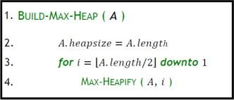
Maintaining the heap property
Goal of build_max_heap() Method:
Transform an unsorted array into a max-heap.
Ensure the heap property:
- Each parent node ≥ its children.
Serve as the foundation for operations like heap sort or priority queues.
Heaps
26/27

Slide 41
Maintaining the heap property
Starting point A[1..n], n = A.length
Goal Turn A into a max-heap!
Tool Max-Heapify() algorithm: “sink” operation
Call Max-Heapify() from the last internal node to the root node (1)
Heaps
26/27

Slide 42
Runtime of Build-Max-Heap
last internal node to the root
Time complexity: Max-Heapify(A, i) runs in O(log n)
Build-Max-Heap(A) calls Max-Heapify() n/2 times
Therefore, the runtime of Build-Max-Heap(A) is
= O(n/2) x O(log n) = O(n log n)
Precise analysis shows most heapify calls are on lower levels (smaller height). Using the aggregate method, total cost is O(n). Final Time Complexity: O(n).
Heaps

Slide 43
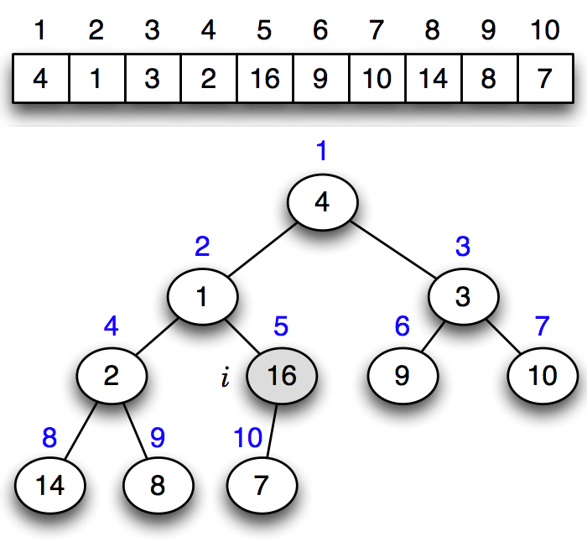
Example of build-max-heap (“heapify”) operation
Mumit Khan

Slide 44
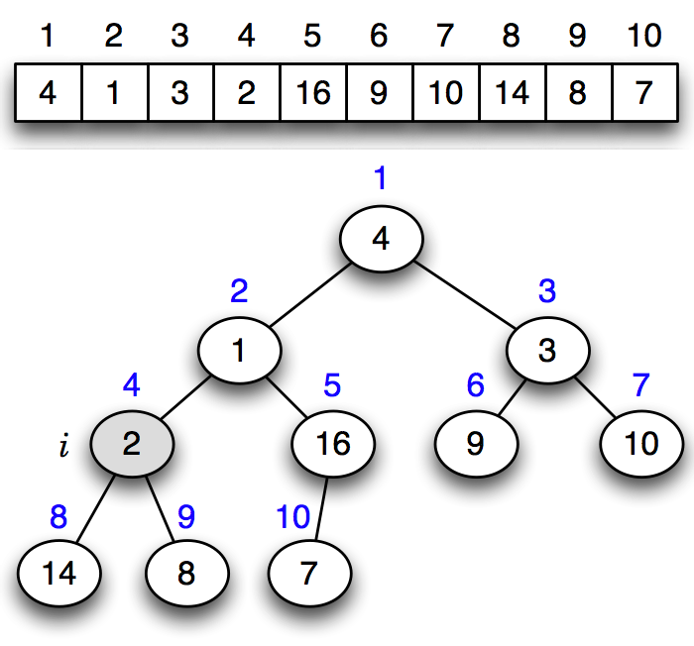
Example of build-max-heap (“heapify”) operation
Mumit Khan

Slide 45
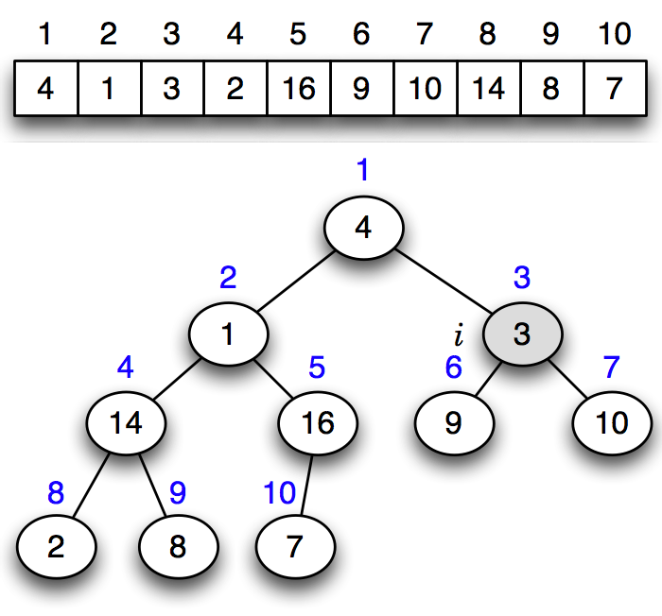
Example of build-max-heap (“heapify”) operation
Mumit Khan

Slide 46
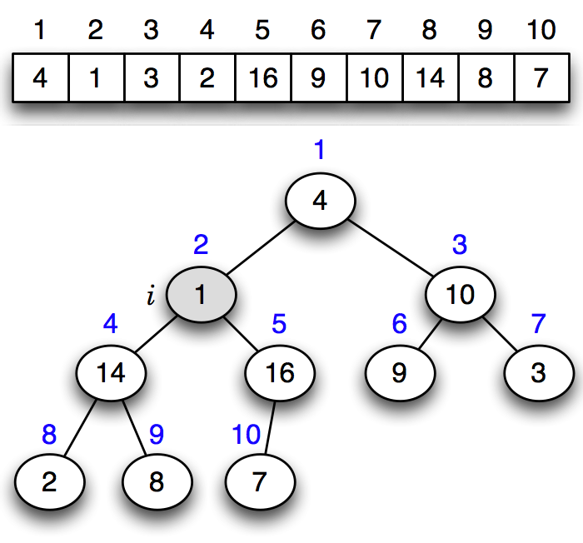
Example of build-max-heap (“heapify”) operation
Mumit Khan

Slide 47
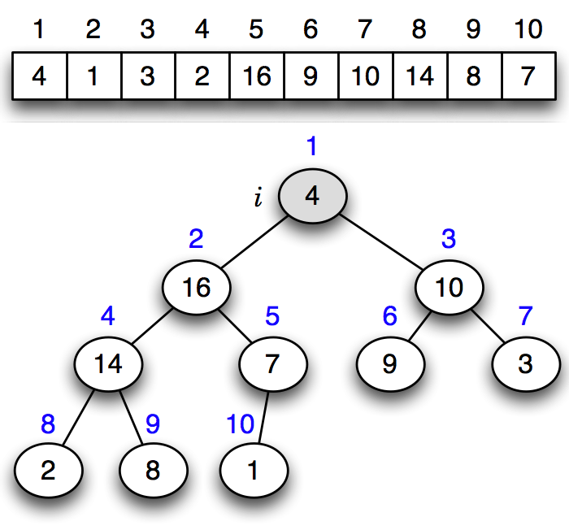
Example of build-max-heap (“heapify”) operation
Mumit Khan

Slide 48
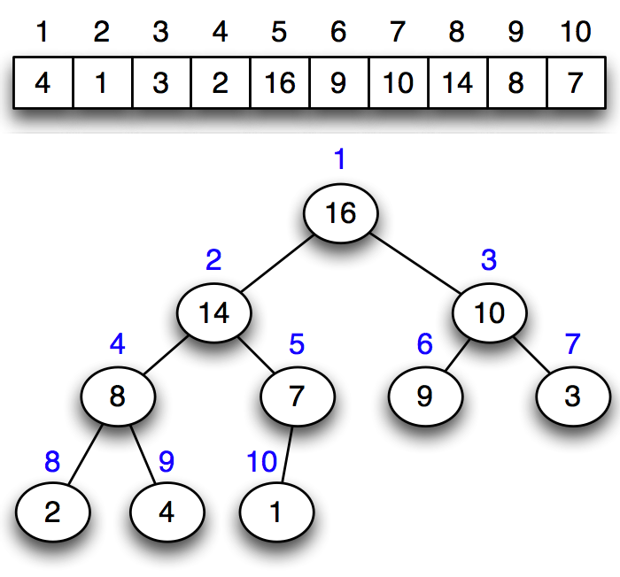
Example of build-max-heap (“heapify”) operation
Mumit Khan

Slide 49
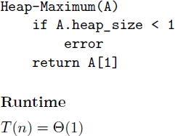
Get maximum value
Priority Queues

Slide 50
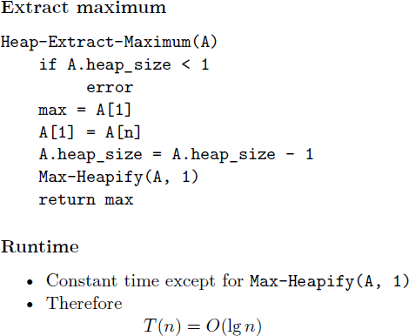
Extract maximum (Referred as “Delete_max” in note)

Slide 51
heap-extract-max algorithm
extract-max(A)
 | cost | times
1 if heap-size[A] < 1 | Θ(1) | 1
2 then error “heap underflow” | Θ(1) | 1
3 max ← A[1] | Θ(1) | 1
4 A[1] ← A[heap-size[A]] | Θ(1) | 1
5 heap-size[A]] ← heap-size[A] − 1 | Θ(1) | 1
6 max-heapify(A, 1) | Θ(lg n) | 1
Worst-case analysis
T (n) = Θ(lg n)
Mumit Khan
28 / 29

Slide 52
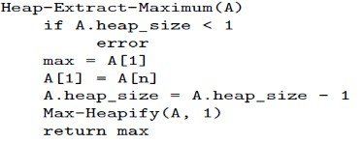
Extract maximum - Example1
Illustrate the operation HEAP-EXTRACT-MAX on the heap A=⟨15,13,9,5,12,8,7,4,0,6,2,1⟩
1. Original heap
Priority Queues

Slide 53
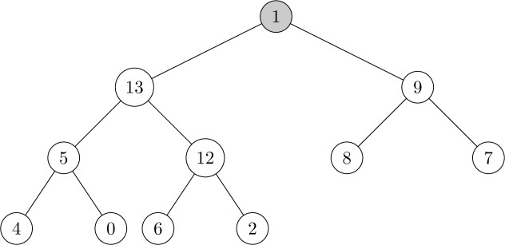
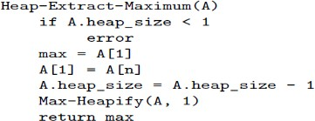
Extract maximum - Example1
Illustrate the operation HEAP-EXTRACT-MAX on the heap A=⟨15,13,9,5,12,8,7,4,0,6,2,1⟩
2. Extract the max node 15, then move 1 to the top of the heap.
Priority Queues

Slide 54
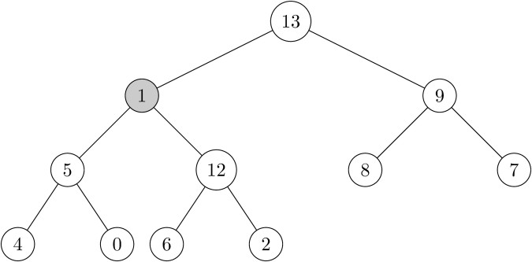
Extract maximum - Example1
Illustrate the operation HEAP-EXTRACT-MAX on the heap A=⟨15,13,9,5,12,8,7,4,0,6,2,1⟩
3. Call max heapify on root. Since 13>9>1, swap 1 and 13.
Priority Queues

Slide 55
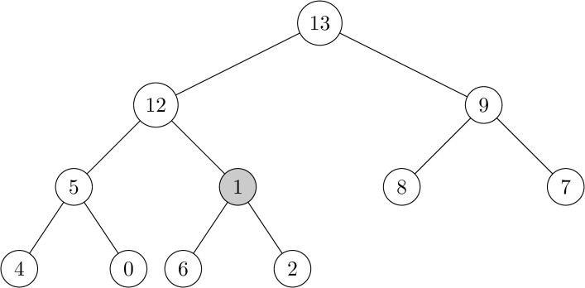
Extract maximum - Example1
Illustrate the operation HEAP-EXTRACT-MAX on the heap A=⟨15,13,9,5,12,8,7,4,0,6,2,1⟩
4. Since 12>5>1, swap 1 and 12.
Priority Queues

Slide 56
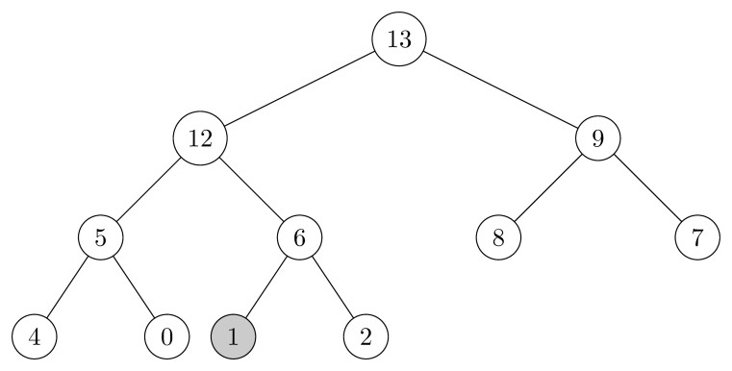
Extract maximum - Example1
Illustrate the operation HEAP-EXTRACT-MAX on the heap A=⟨15,13,9,5,12,8,7,4,0,6,2,1⟩
5. Since 6>2>1, swap 1 and 6
Priority Queues

Slide 57
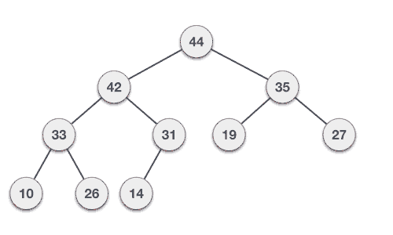
heap-extract-max operation (Example3)
Mumit Khan
27 / 29

Slide 58
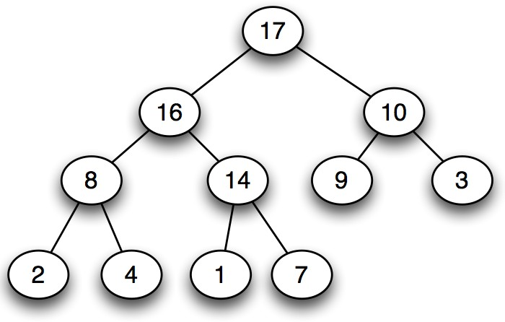
heap-extract-max operation (Example2)
Mumit Khan
27 / 29

Slide 59
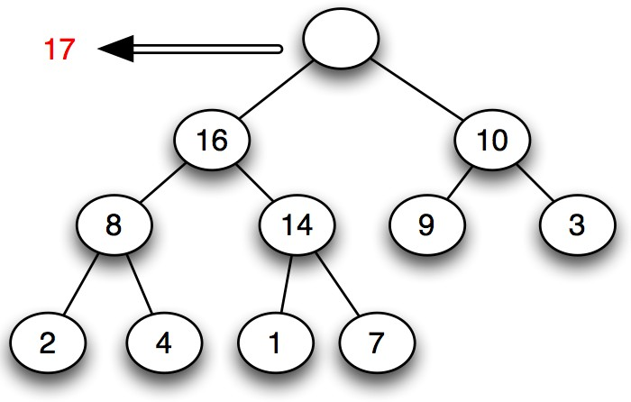
heap-extract-max operation (Example2)
Mumit Khan
27 / 29

Slide 60
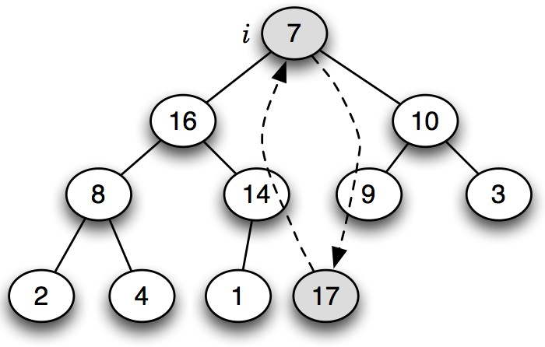
heap-extract-max operation (Example2)
Mumit Khan
27 / 29

Slide 61
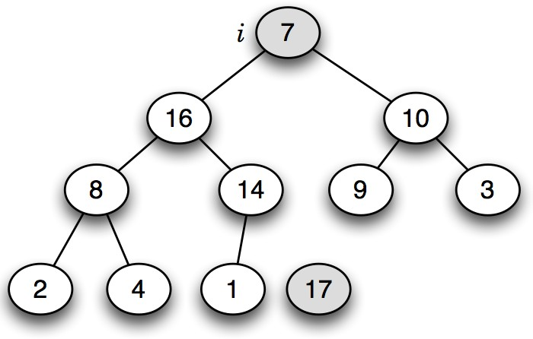
heap-extract-max operation (Example2)
Mumit Khan
27 / 29

Slide 62

heap-extract-max operation (Example2)
Mumit Khan
27 / 29

Slide 63
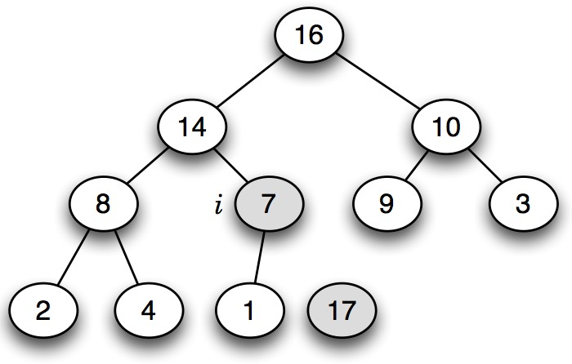
heap-extract-max operation (Example2)
Mumit Khan
27 / 29

Slide 64

heap-extract-max operation (Example2)
Mumit Khan
27 / 29

Slide 65
The Heapsort Algorithm
Starting point Any array A[1..n]
Goal Array sorted in ascending order, in-place.
Works like selection sort by dividing input into sorted and unsorted regions
In-Place Sorting: Sorting is performed without using extra space for another array, only modifying the input array.
Examples of In-Place Sorting Algorithms Bubble Sort, Selection Sort, Insertion Sort, Heapsort, Quicksort
Heaps

Slide 66
The Heapsort Algorithm
Differences in Sorting Order
Max Heap: Sorts in ascending order by repeatedly moving the largest elements to the end.
Min Heap: Sorts in descending order by repeatedly moving the smallest elements to the end.
Heap Type | Sorting Order | Key Element Moved | Re-Heapify Operation
Max Heap | Ascending Order | Largest to End | Maintain Max Heap, calls max-heapify
Min Heap | Descending Order | Smallest to End | Maintain Min Heap, calls min-heapify
Heaps

Slide 67

The Heapsort Algorithm
Explanation
Turn A[1..n] into max-heap.
A[1] is now largest element.
Swap A[1] and A[n], n=heap_size
Reduce heap size to n - 1
and call max-heapify on the root
5.Now, A[n] contains largest element (is sorted) and A[1..n - 1] is max-heap.
Repeat until entire array is sorted.
Works like selection sort by dividing input into sorted and unsorted regions.
Heapsort

Slide 68

The Heapsort Algorithm
Source: https://www.lavivienpost.net/heapsort-gif/

Slide 69
Heapsort algorithm
heapsort(A)
 | cost | times
1 build-max-heap(A) | Θ(nlogn) | 1
2 for i ← length[A] downto 2 | Θ(1) | n
3 do exchange A[1] ↔ A[i ] | Θ(1) | n − 1
4 heap-size[A] ← heap-size[A] − 1 Θ(1) |  | n − 1
5 max-heapify(A, 1) | Θ(lg n) | n − 1
Worst-case analysis
T (n) = Θ(n lg n)+ Θ(n lg n) = Θ(n lg n)
Mumit Khan
24 / 29

Slide 70

Heapsort algorithm simulation
Mumit Khan
23 / 29

Slide 71

Heapsort algorithm simulation
Mumit Khan
23 / 29

Slide 72

Heapsort algorithm simulation
Mumit Khan
23 / 29

Slide 73

Heapsort algorithm simulation
Mumit Khan
23 / 29

Slide 74

Heapsort algorithm simulation
Mumit Khan
23 / 29

Slide 75

Heapsort algorithm simulation
Mumit Khan
23 / 29

Slide 76

Heapsort algorithm simulation
Mumit Khan
23 / 29

Slide 77

Heapsort algorithm simulation
Mumit Khan
23 / 29

Slide 78

Heapsort algorithm simulation
Mumit Khan
23 / 29

Slide 79

Heapsort algorithm simulation
Mumit Khan
23 / 29

Slide 80

Heapsort algorithm simulation
Mumit Khan
23 / 29

Slide 81

Heapsort algorithm simulation
Mumit Khan
23 / 29

Slide 82

The Heapsort Example
Heapsort

Slide 83

Heapsort algorithm Simulation
Source: https://yaswa779.medium.com/introduction-to-heap-sort-edad68e6b0d1
Mumit Khan
24 / 29

Slide 84
Try out Interactive Max Heap Simulation by Visualgo.net (https://visualgo.net/en/heap)
Interactive simulations

Slide 85
The End

